Slide 1

Yeshwantrao Chavan College of Engineering
PROJECT SEMINAR
Session 2023-24
IOT based manual and automated monitoring and controlling for cold storage system
By
Group-17
Harshal Borkar
Sankit Binkar
Aditya Pethe
Soniya Rangari
Guide
Prof Jiwan N. Dehankar

Slide 2
Problem definition
To monitor and control the environment of the cold storage system for maintaining quality of item and increase the life span.

Slide 3
Introduction
Abstract
Many of the food import and export industries are facing issues for maintaining quality and lifespan of food in food storage. The actual problem received is for storing bananas. The issue is that after power cuts off, there is rapid growth of bacteria's and microorganism due to which bananas get rotten which result in huge loss. They want a system which can help in monitoring of storage environment which can be remotely controlled. The system must be able to release the specific amount of ethylene gas for specific amount of time.
So we are providing a solution by designing a system using microcontroller, different kind of IoT components, sensors and web technology. The system will be able to monitor and analyze environment and it will release ethylene gas. The user can remotely set the time and amount of gas.

Slide 4
Introduction
Bananas are highly perishable and require ripening chambers to increase shelf life. These chambers control temperature and release ethylene gas, reducing the ripening process to four to six days for optimal quality. Automatic temperature monitoring in cold storage facilities is crucial for crew efficiency. This work introduces a novel cold storage optimization tactic incorporating IoT technology. The system includes a DHT11 temperature and humidity sensor, Relays, a gas sensor, and a microcontroller for data collection and refrigeration system.
Proposed Industry Requirement

Slide 5
Introduction
Aim and Objective
To provide remote access and control to the client of cold storage system .
To monitor the cold storage environment.
To develop alert system for client.
To develop web-app.
To maintain quality and increase life span of food.
Control the growth of bacteria & micro-organisms.
To maximize profit.

Slide 6
Literature Review
Sr.no | Title of Paper | Major observation
1 | Maged Mohammed, Khaled Riad, Nashi Alqahtani, “Design of a Smart IoT-Based Control System for Remotely Managing Cold Storage Facilities”. Sensors 2022, 22(13), 4680 (2022). | Displays the maintenance status in cold chain plants. Collect environmental data such as temperature and humidity. Cloud server module is used to deliver communication data
2 | Yanlin T, Zuoxin Hu, Tianyu T, Xin Gao, “Effect of goods stacking mode on temperature field of cold storage”. Proceedings of EEEP 2020 IOP Conference Series: Earth and Environmental Science. Volume 675(1): 012052, 5th ICEEEP, IOP Publishing. Orlando, FL (2021). | Adopt WSN based continuous monitoring of temperature and humidity of the cold storage warehouses

Slide 7
Literature Review
Sr.no | Title of Paper | Major observation
3 | Hina Afreen, Imran Sarwar Bajwa, “An IoT-Based Real-Time Intelligent Monitoring and Notification System of Cold Storage”. IEEE Access PP(99): 1-1. (Volume 9), ISSN: 2169-3536, (2021). | Use of API for alert system
4 | Santoso Budijono, Felita, “Smart Temperature Monitoring System Using ESP32 and DS18B20”. 4th International Conference on Eco Engineering Development 2020, Banten, Indonesia. IOP Conf. Series: Earth and Environmental Science, Volume: 794 012125 (2021). | System architecture, software design, system flow method, and other technical benefits are all fully utilized by this application To ensure the quality of cold chain products across the supply chain, the system can track the location and temperature of those products in real-time.

Slide 8
HARDWARE AND SOFTWARE REQUIRMENT
Microcontroller - ESP-32 8266
Temperature and Humidity Sensor – DHT11
Gas sensor – MQ3
Relay Module – 5V
SMPS (Switched Mode Power Supply)
LCD Display
Resistors, Transistors, Diodes
Arduino IDE
VS code
Web technology
MySQL Data Base
ThingSpeak

Slide 9
PLAN OF ACTION
The system uses Master NodeMCU to send data to cloud server. On the web-based Control Panel fields are there which display recorded values of Temperature, Humidity and Gas Sensor. DHT11 Temperature and MQ-3 gas sensor are connected to the Slave controller. These sensors are used to measure and monitor temperature, humidity and gas values present in the cold storage chamber, respectively. Relay 1 is connected to slave ESP controller to turn Air Conditioner ON and OFF. LCD display of 16*2 is used to display temperature and gas values sensed by sensors. Relay 2 is connected to master ESP controller for operation of Ethylene gas cylinder.
Steps:
Study of working of required components.
Individual testing of components.
Integrating IoT hardware components.
Integrating different components code with hardware and testing.
Developing frontend and backend for client.
Integrating software and hardware.
Advancing the system with cloud (Remote access).

Slide 10
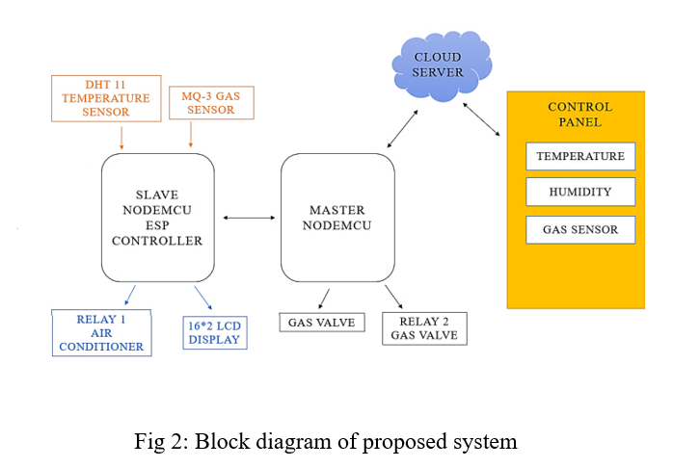
PLAN OF ACTION

Slide 11
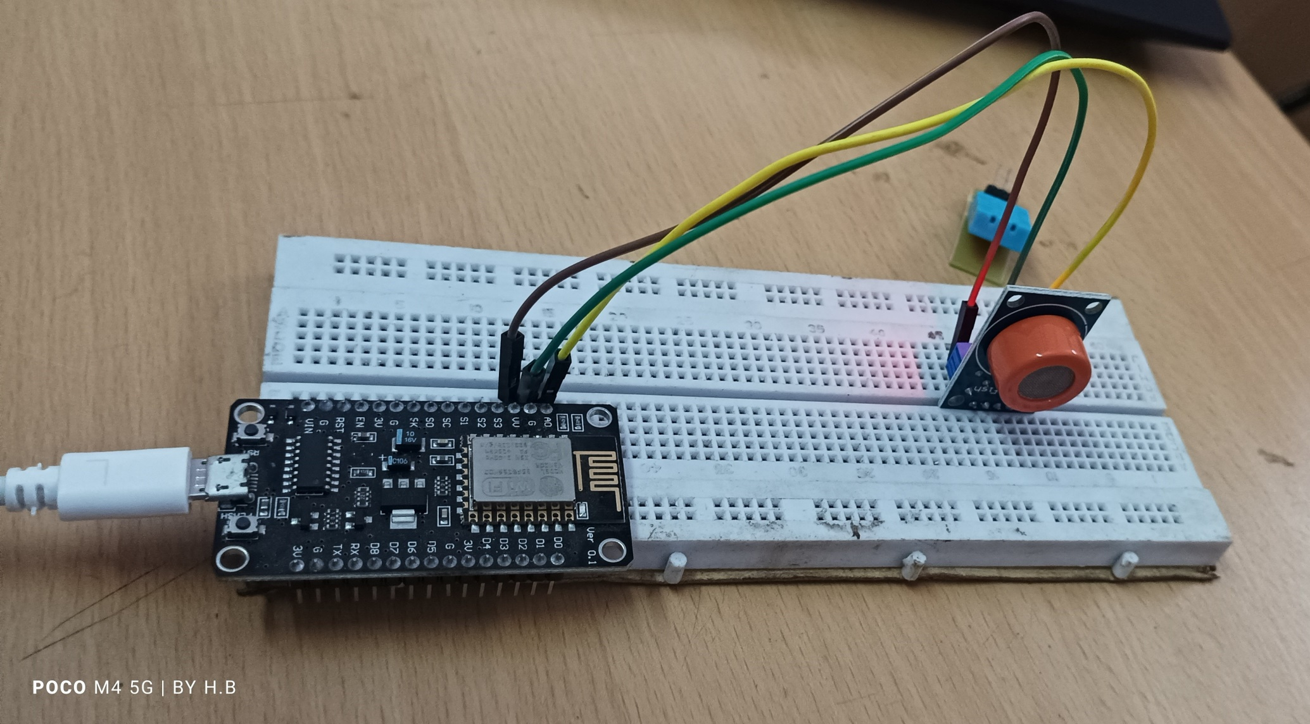
PLAN OF ACTION
Testing of Gas Sensor MQ3

Slide 12
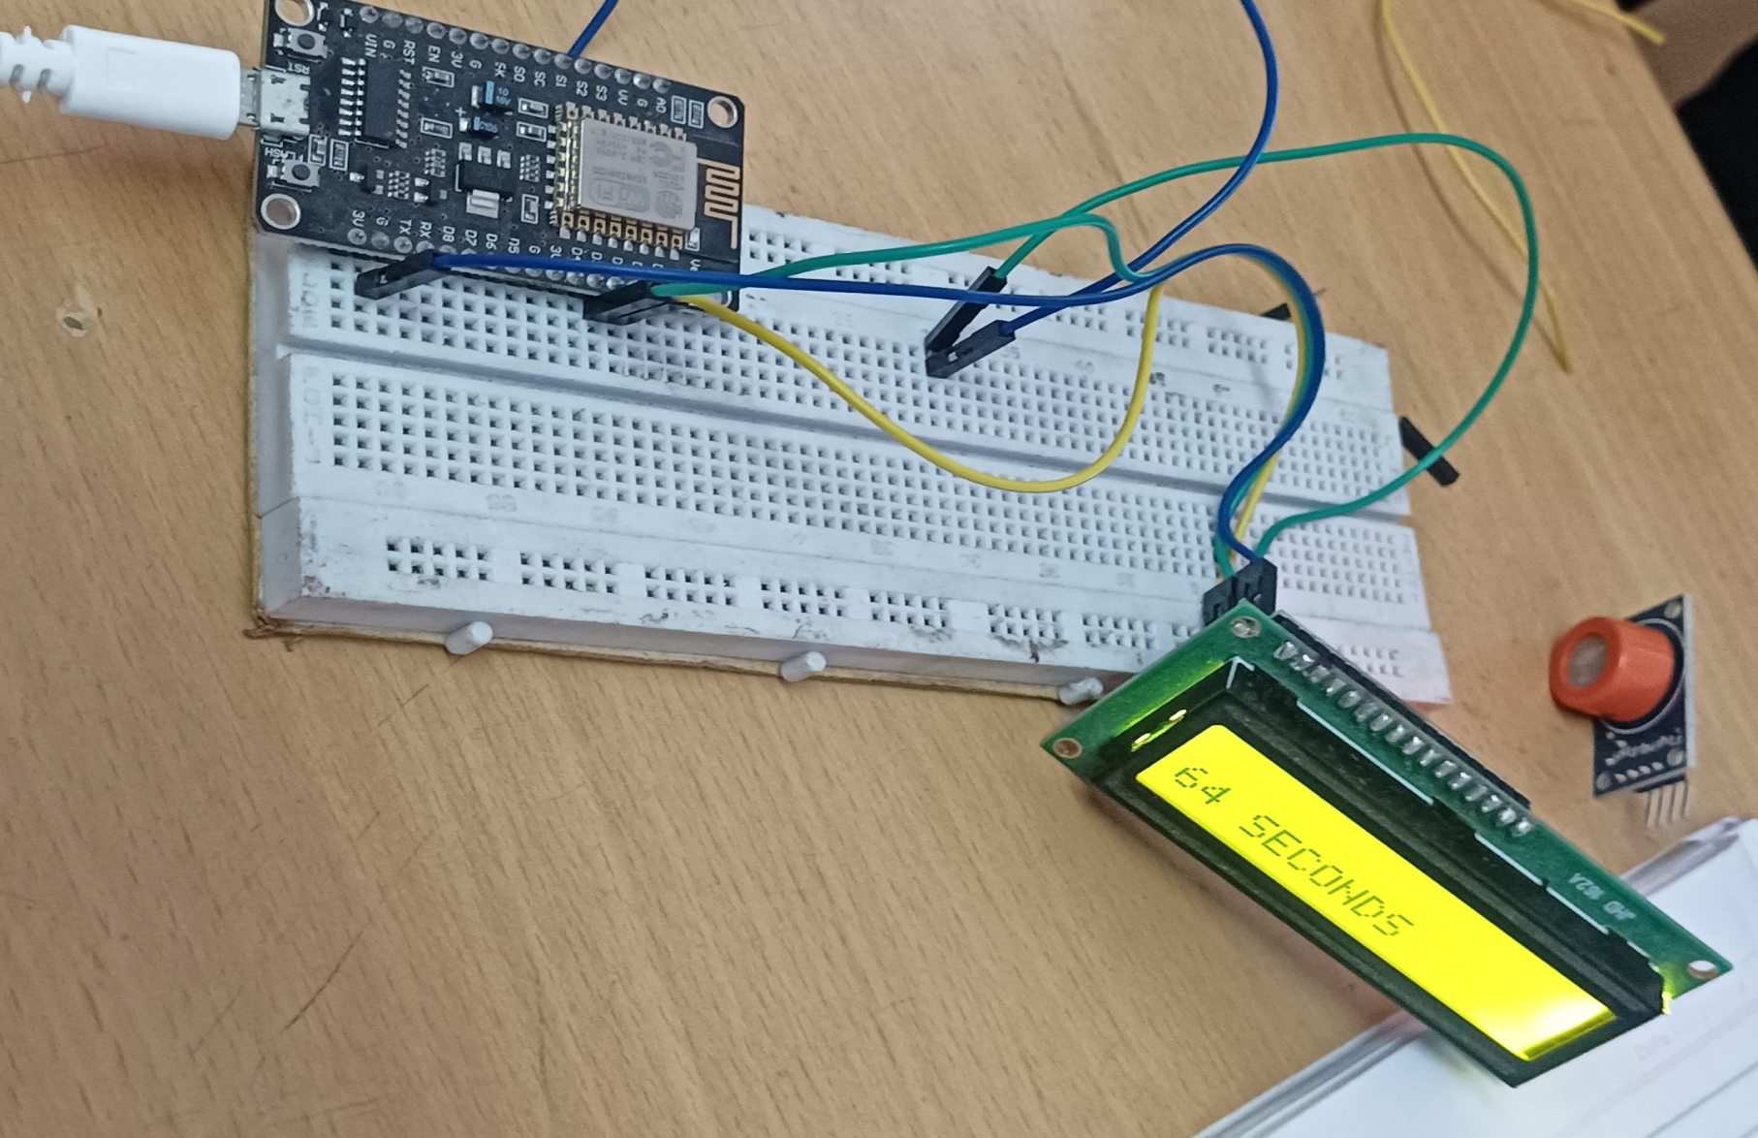
PLAN OF ACTION
Testing of Display Unit – LCD

Slide 13
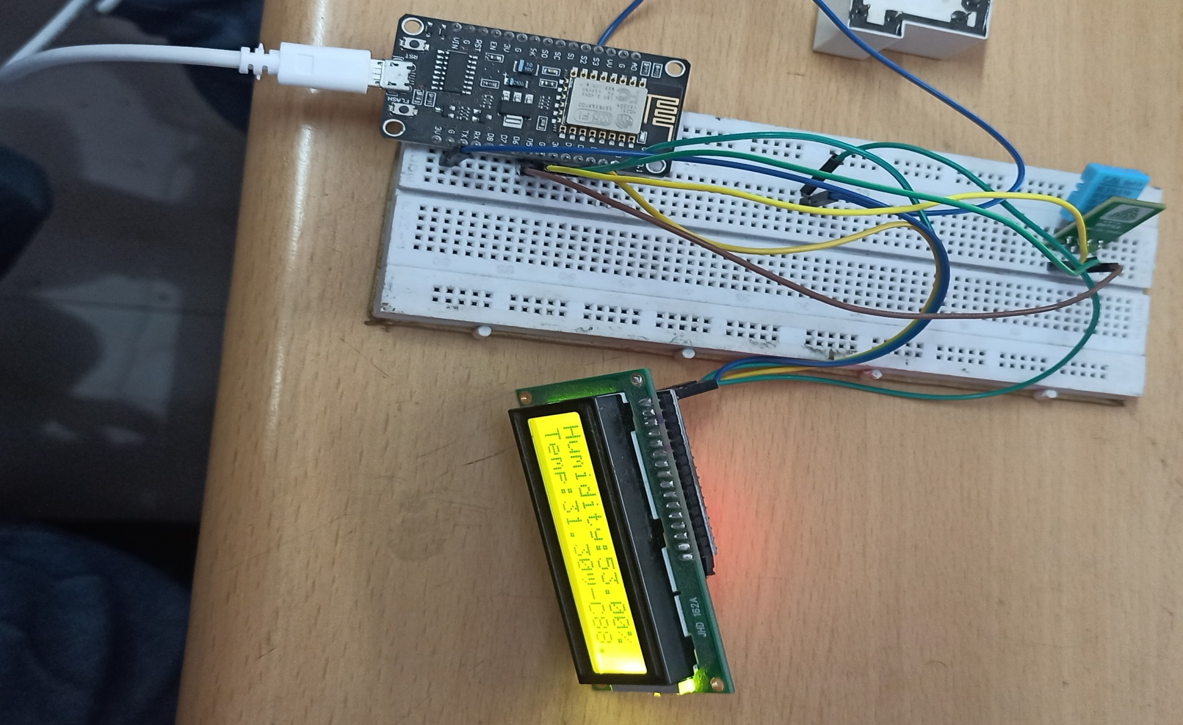
PLAN OF ACTION
Testing of Humidity and Temperature sensor- DHT11

Slide 14
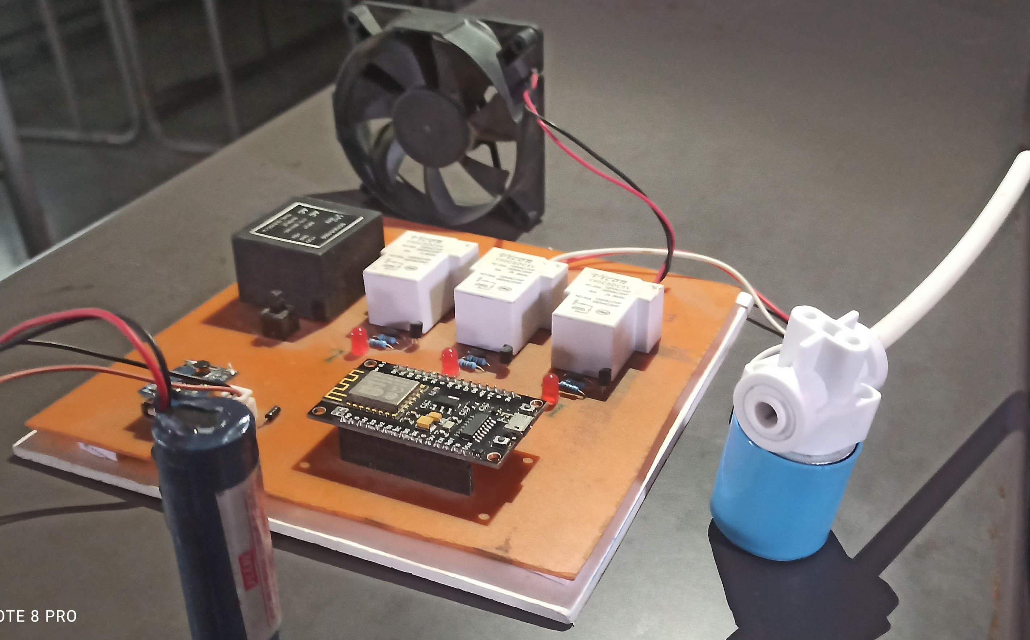
PLAN OF ACTION
Integration of Controlling Unit

Slide 15
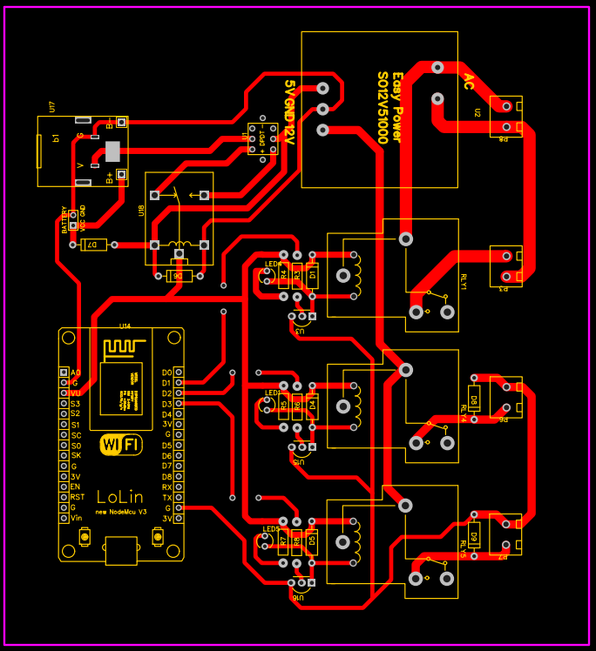
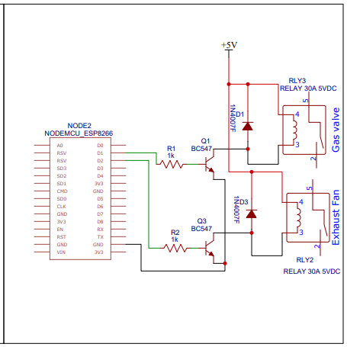
PLAN OF ACTION
Circuit Diagram For Controlling Unit

Slide 16
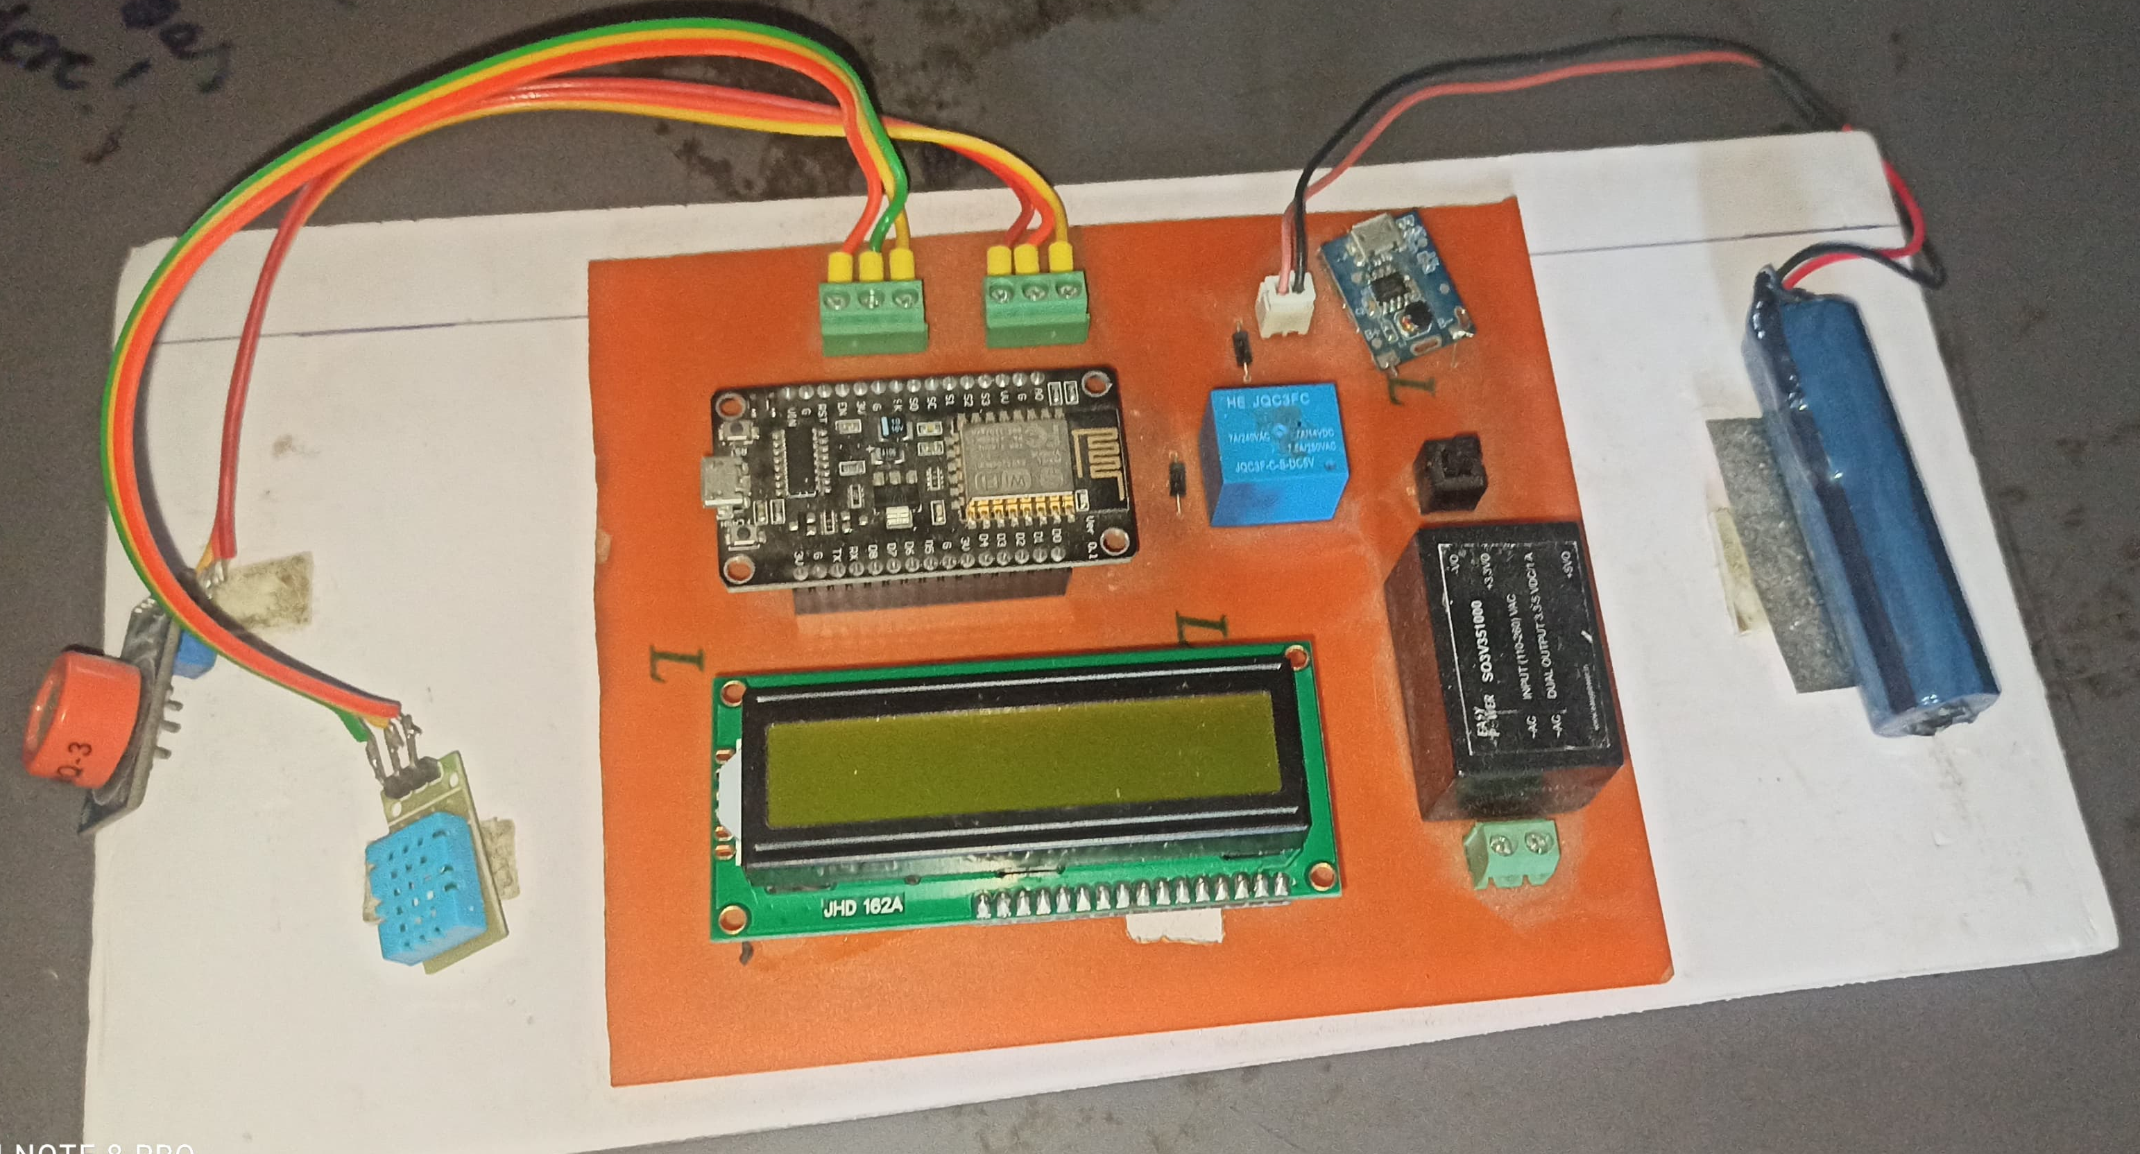
PLAN OF ACTION
Integration of Monitoring Unit

Slide 17
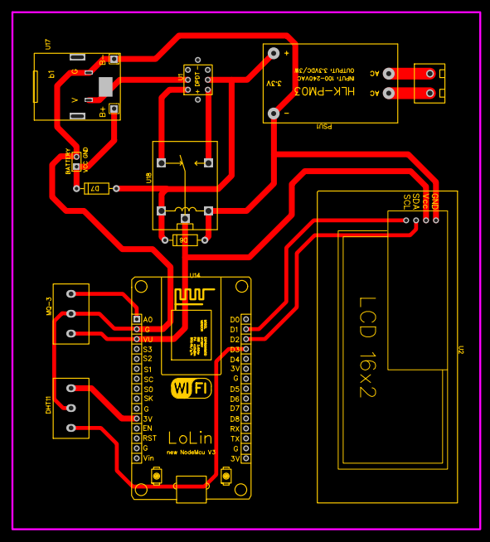
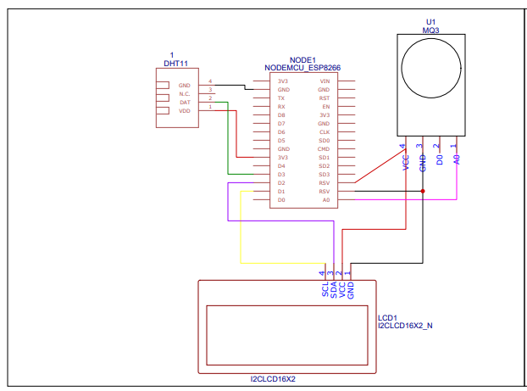
PLAN OF ACTION
Circuit Diagram For Monitoring Unit

Slide 18
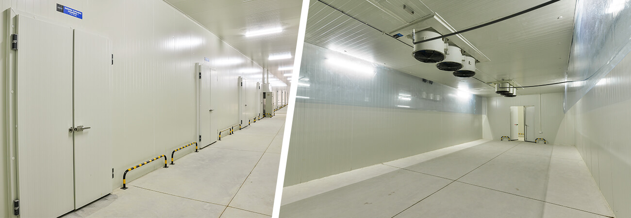
PLAN OF ACTION
Banana Ripening Chamber

Slide 19
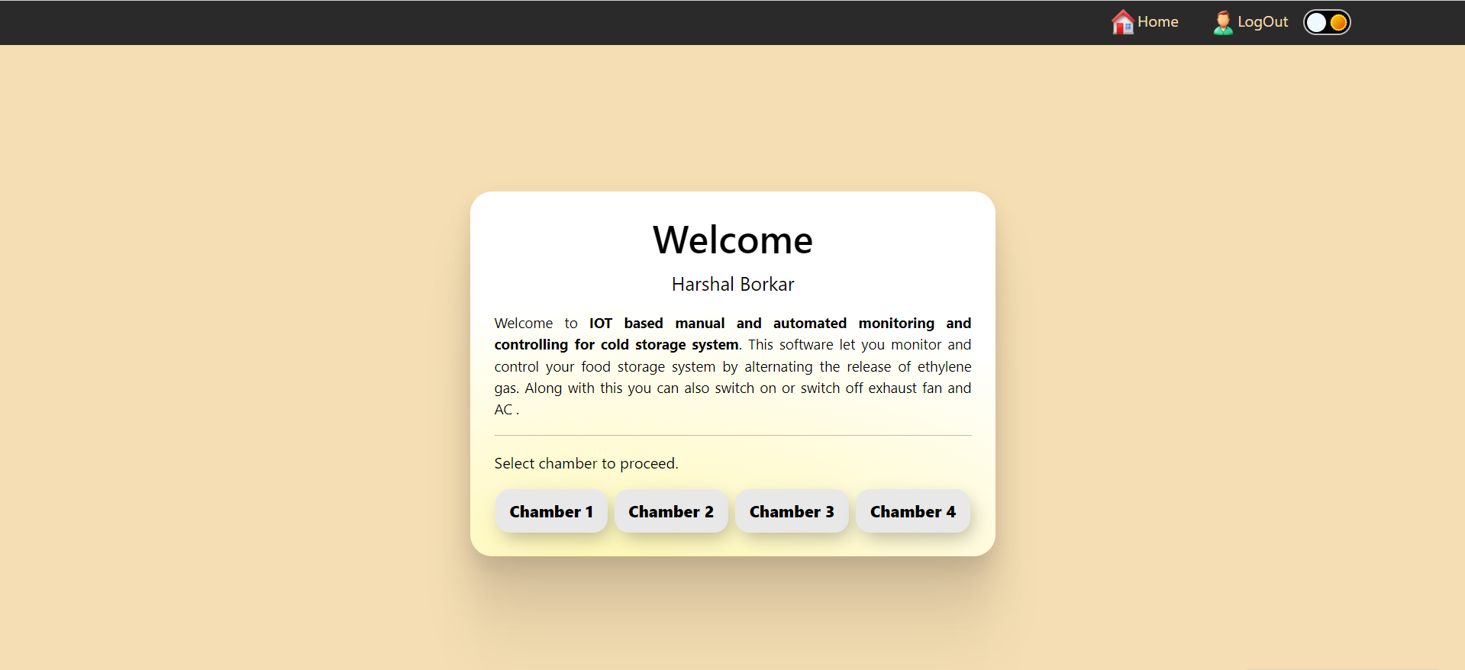
PLAN OF ACTION

Slide 20
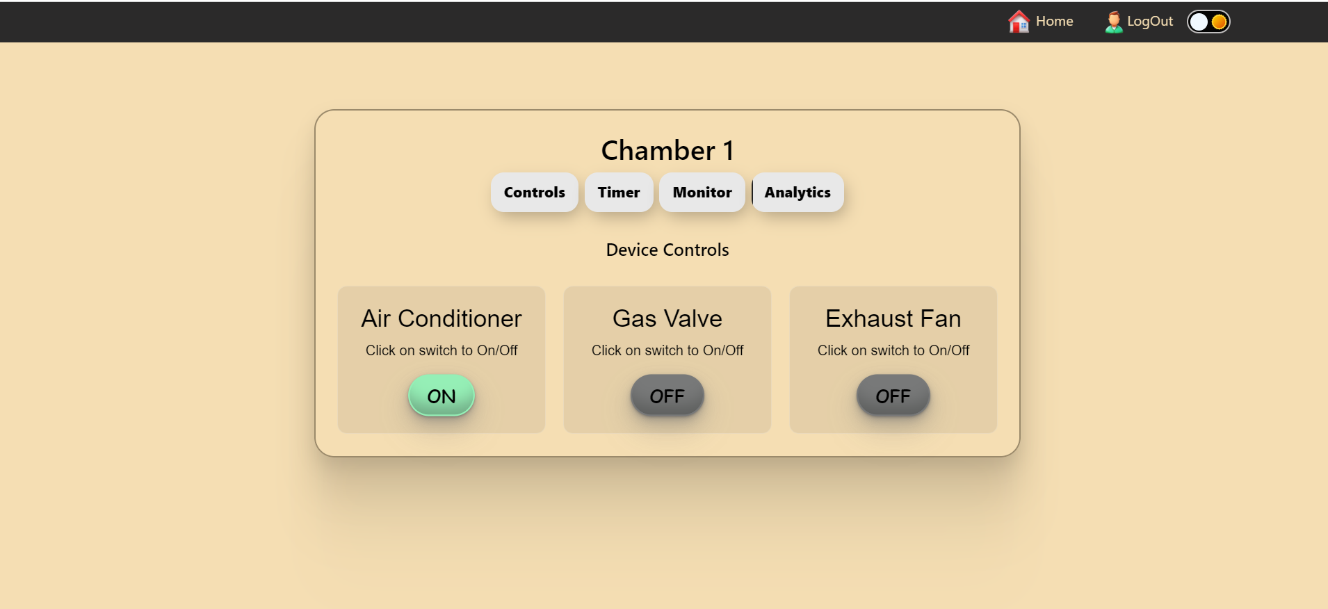
PLAN OF ACTION

Slide 21
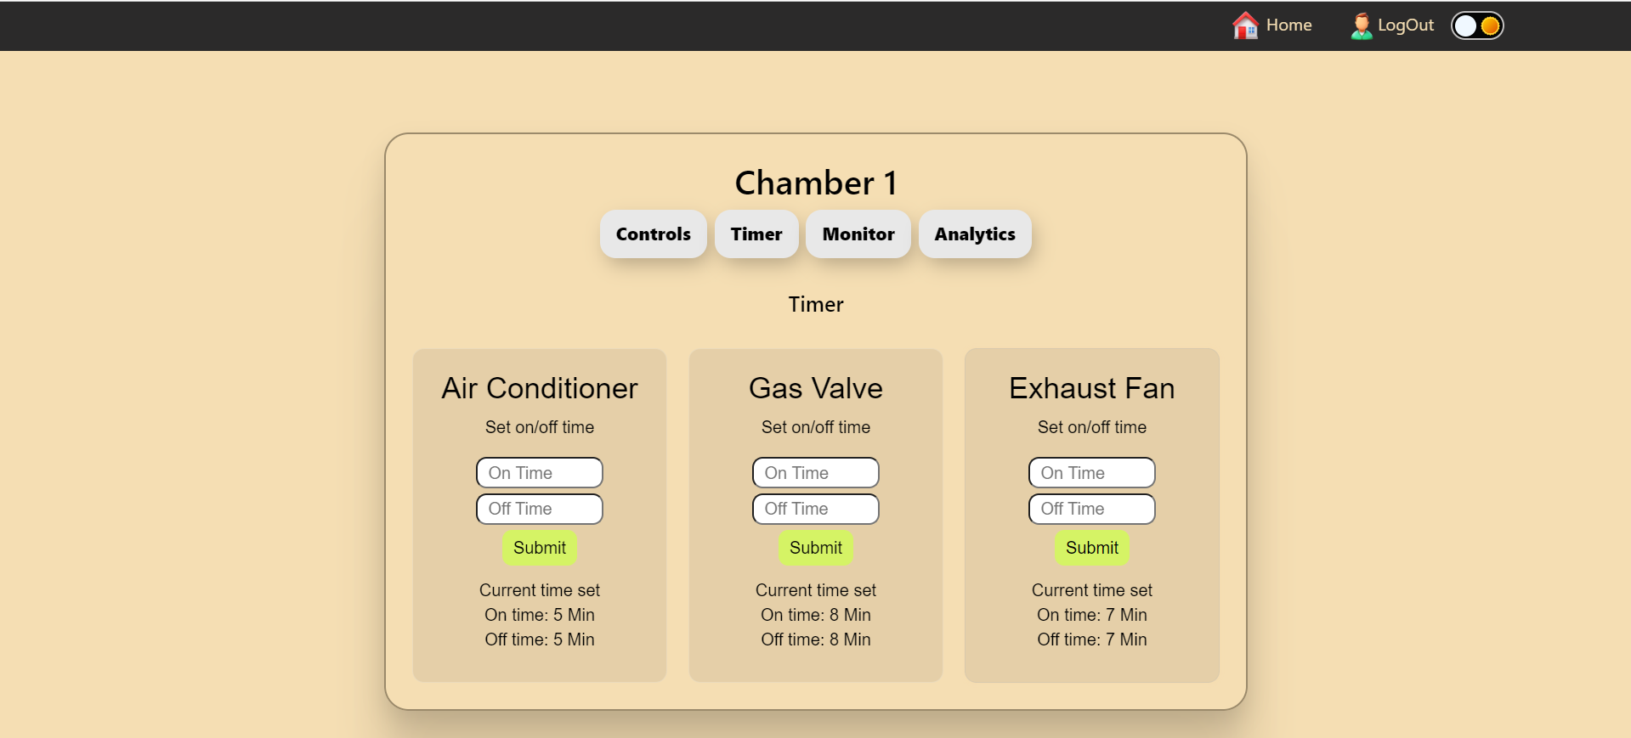
PLAN OF ACTION

Slide 22
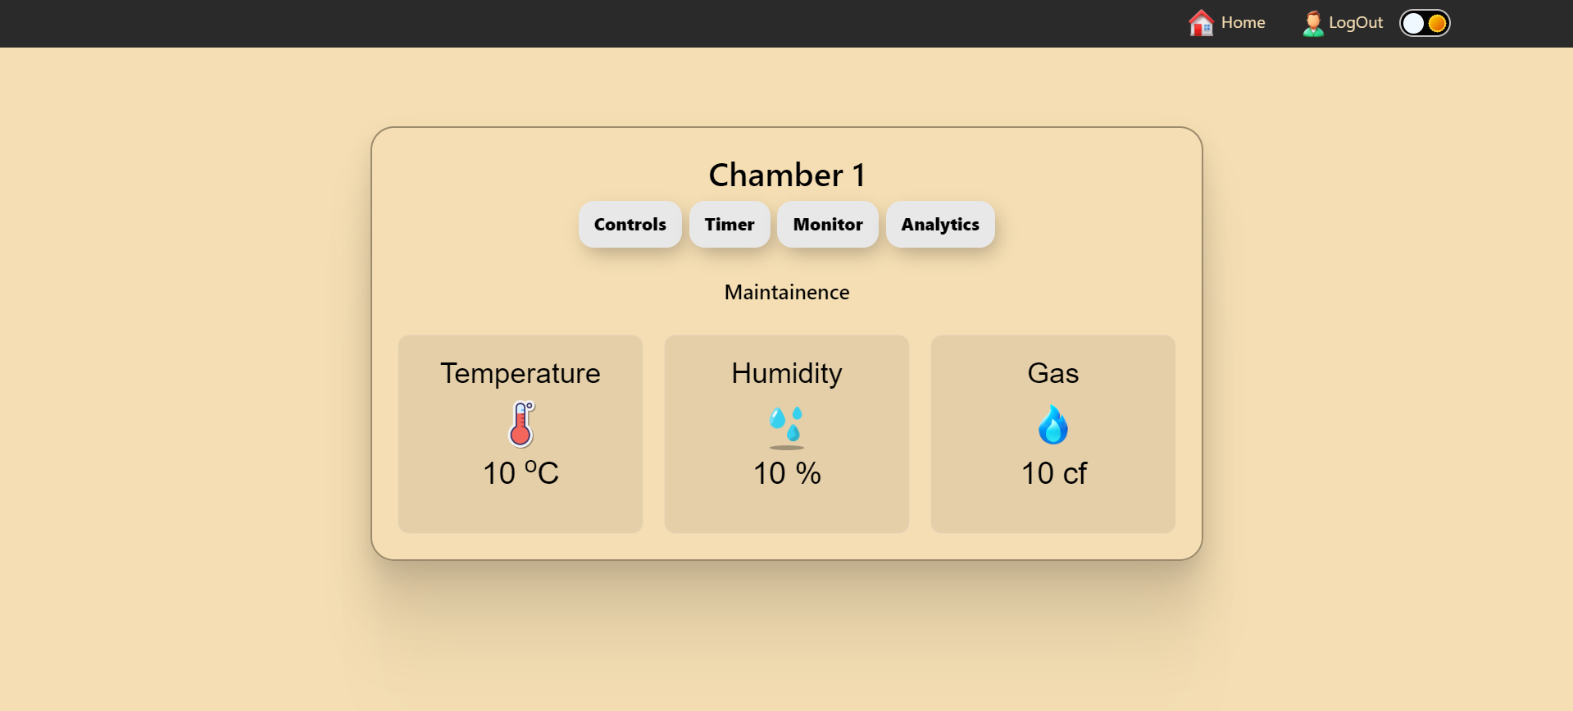
PLAN OF ACTION

Slide 23
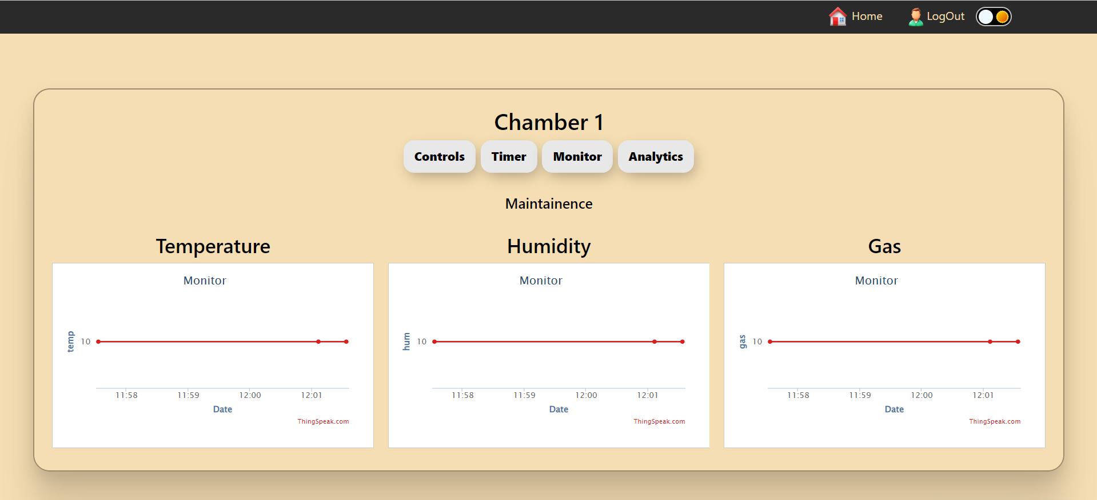
PLAN OF ACTION

Slide 24
Result and Discussion
Integration and Efficiency:
The system successfully integrates sensors and controllers for monitoring and control.
The Master NodeMCU efficiently transmits data to the cloud server via a web-based Control Panel.
DHT11 Temperature and MQ-3 gas sensors accurately measure temperature, humidity, and gas levels in the cold storage chamber.
Critical Components:
Relay 1 operates the Air Conditioner, maintaining desired storage conditions.
Relay 2 on the master ESP controller effectively manages the Ethylene gas cylinder, preventing banana ripening during storage.

Slide 25
Result and Discussion
Efficacy and Reliability:
The IoT system addresses banana storage requirements effectively.
Seamless communication, cloud integration, and sensor accuracy contribute to a reliable solution.
Versatility and Potential:
Multiple sensors enhance the system’s capability to maintain optimal storage conditions.
Successful Ethylene gas control demonstrates practicality and potential for broader food industry applications.
Future enhancements could explore additional features and scalability.

Slide 26
Conclusion
In conclusion, the developed IoT based manual and automated monitoring and controlling for cold storage system has proven to be a robust and effective solution for banana storage, specifically designed to prevent ripening. The integration of Master NodeMCU, Slave controller, sensors, and relays ensures accurate monitoring and control of critical environmental parameters such as temperature, humidity, and gas levels. The successful operation of the Air Conditioner and Ethylene gas cylinder demonstrates the system's ability to maintain optimal storage conditions and prevent premature ripening of bananas.
The user-friendly web-based Control Panel and LCD display enhance accessibility and provide a convenient interface for users to monitor and manage the storage environment. Overall, the system fulfills its intended purpose of extending the shelf life of bananas by creating an ideal storage atmosphere.

Slide 27
Price Comparison
 | Traditional CSR | IOT-based CSR
Equipment cost | ₹45,000 | ₹50,000
Cloud Deployment | NA | ₹20,000
Installation | ₹5,000 | ₹10,000
Maintenance | ₹20,000 | NA
Total | ₹70,000 | ₹80,000

Slide 28
Patentability
Related Patent:
Title: Design of a Smart IoT-Based Control System for Remotely Managing Cold Storage Facilities
Features:
Remote Monitoring and Control
Cold storage environment monitoring through sensors
Microcontroller-based Control
Energy Efficiency
Customization and Scalability
G-17 Project:
Title: IOT based manual and automated monitoring and controlling for cold storage system
Additional Features:
Alert System
Automated Control If System Is Ieft idle
Integration with IoT Platforms

Slide 29
References
Maged Mohammed, Khaled Riad, Nashi Alqahtani, “Design of a Smart IoT-Based Control System for Remotely Managing Cold Storage Facilities”. Sensors 2022, 22(13), 4680 (2022).
Yanlin T, Zuoxin Hu, Tianyu T, Xin Gao, “Effect of goods stacking mode on temperature field of cold storage”. Proceedings of EEEP 2020 IOP Conference Series: Earth and Environmental Science. Volume 675(1): 012052, 5th ICEEEP, IOP Publishing. Orlando, FL (2021).
Santoso Budijono, Felita, “Smart Temperature Monitoring System Using ESP32 and DS18B20”. 4th International Conference on Eco Engineering Development 2020, Banten, Indonesia. IOP Conf. Series: Earth and Environmental Science, Volume: 794 012125 (2021).
Hina Afreen, Imran Sarwar Bajwa, “An IoT-Based Real-Time Intelligent Monitoring and Notification System of Cold Storage”. IEEE Access PP(99): 1-1. (Volume 9), ISSN: 2169-3536, (2021).

Slide 30

Thank You…….
QR Code to web application
Link to web application:
https://coldstoragemonitor.000webhostapp.com/

